Slide 1
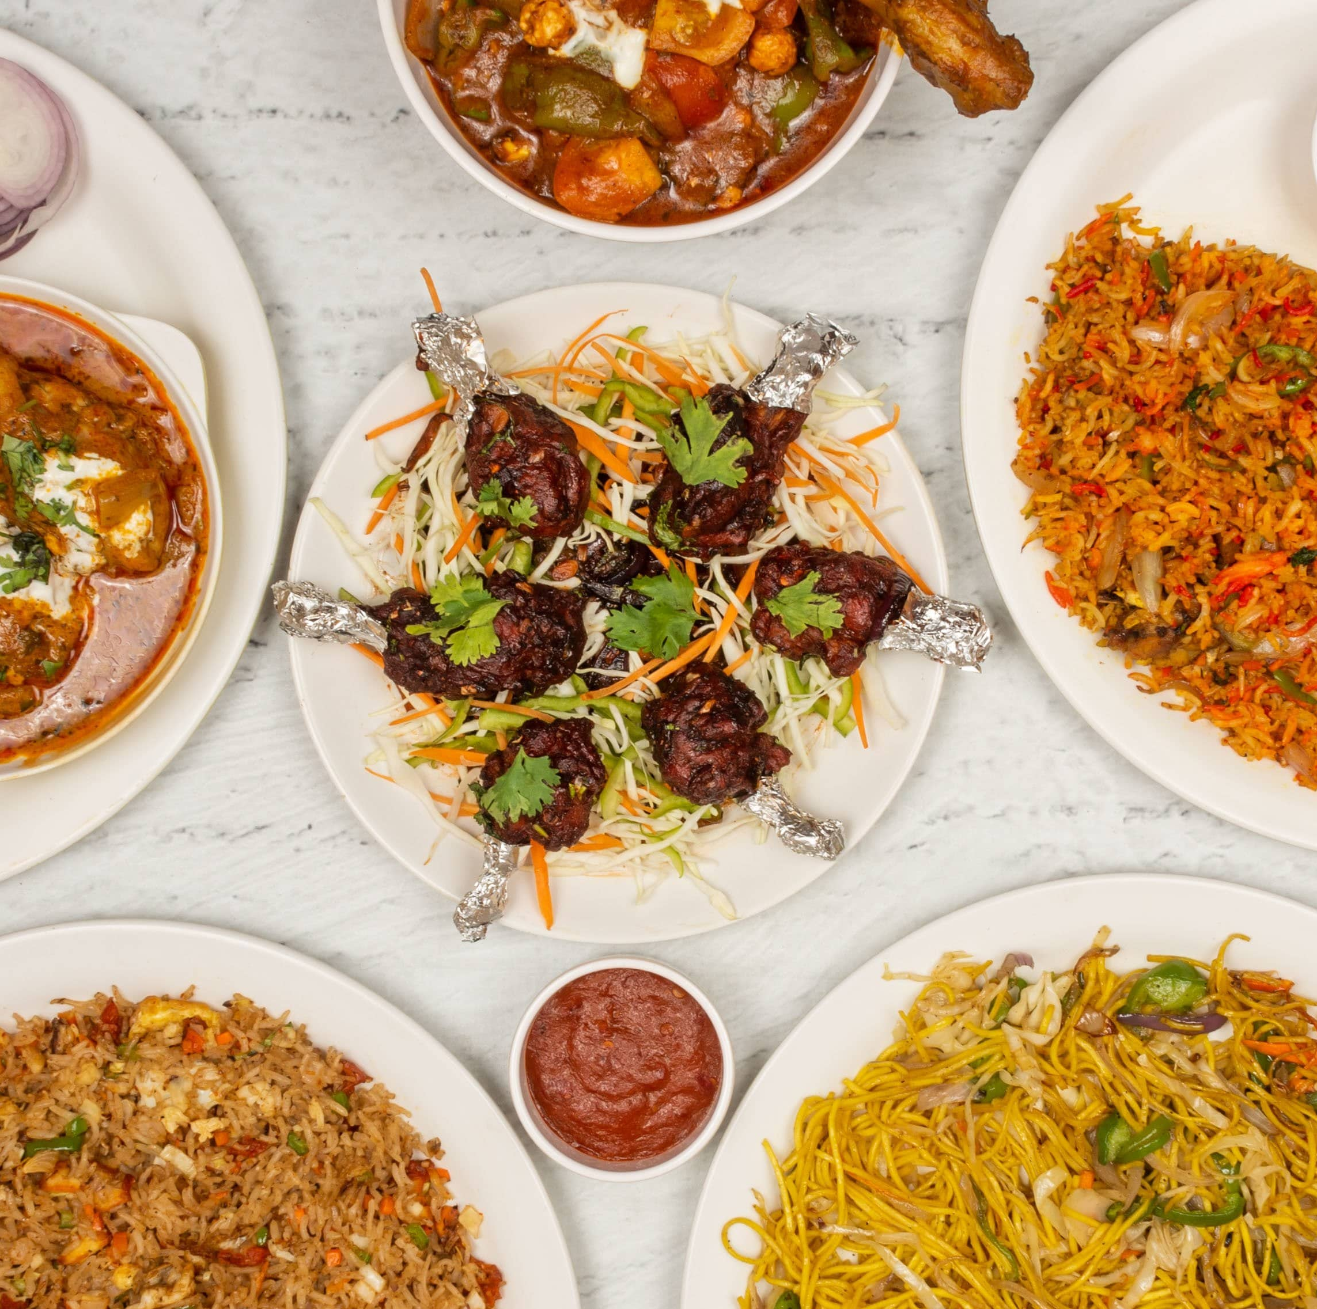

4P FOOD
Member of group:
CE130353 - Nguyễn Minh Thảo
CE130377 - Nguyễn Thành Nhân
CE130252 - Nguyễn Chí Linh
CE130364 - Cao Văn Kha
CE130213 - Dương Trọng Nhân

Slide 2
Table of Content
1
Problem definition
2
Actor
3
Sitemap
4
Demo
5
Any questions

Slide 3
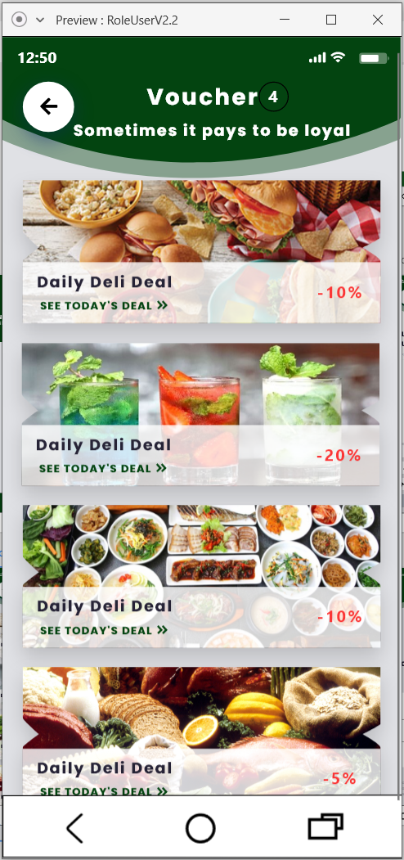
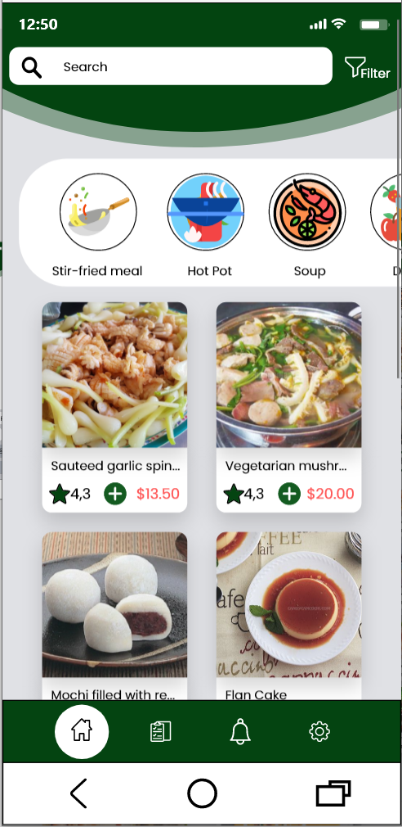
Problem definition
1. What?
It’s a order food application and a website manage food, employee…
2. How?
For client: every one can order food and table at our restaurant.
For restaurant owner: we can manage food, employee, client, analysis revenue.

Slide 4
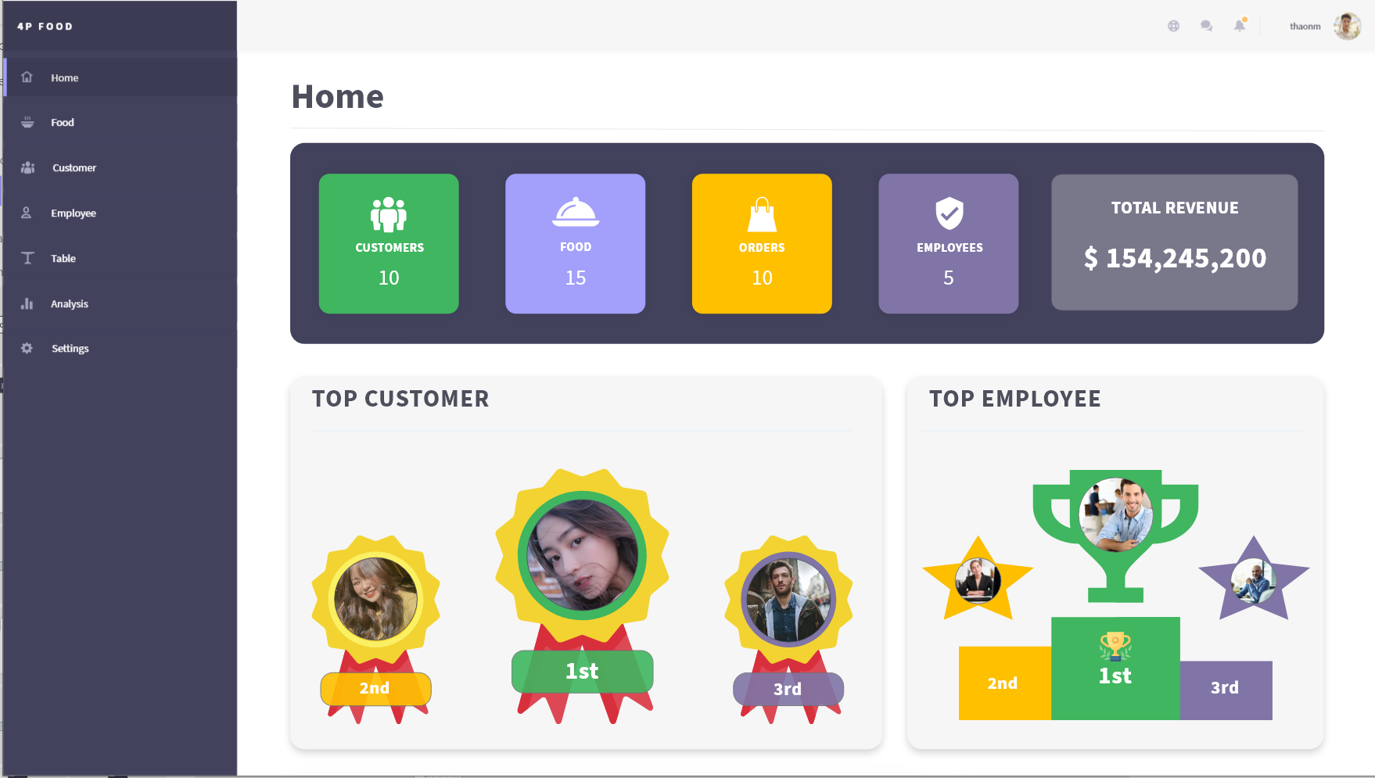
Application
3. Why?
For client:
The best place to meeting friends, boss, girl friend.
Avoid running out of tables when you arrive at the restaurant
For restaurant owner:
Can manage employee, customer easily.
Analysis revenue. From which we can develop and improve pros and cons.

Slide 5
Actors
Admin: the restaurant owner who has all of permission.
Employee: the employees who can check table, food available.
Client: the people who can order food and table in their phone.

Slide 6



Sitemap
Admin
Management
Analysis
Setting

Slide 7
Sitemap
Admin

Slide 8
Sitemap
Admin

Slide 9
Sitemap
Admin

Slide 10
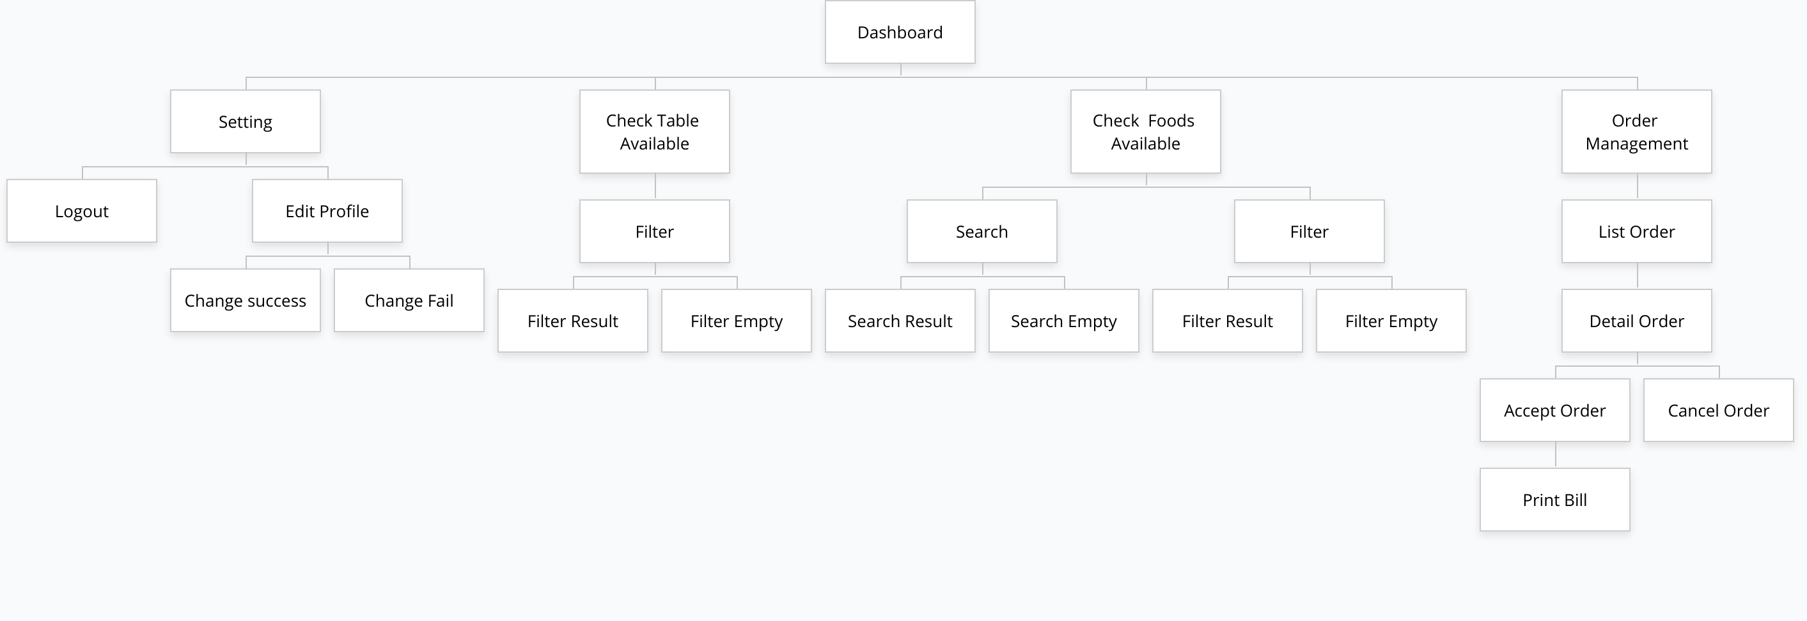
Sitemap
Employee

Slide 11
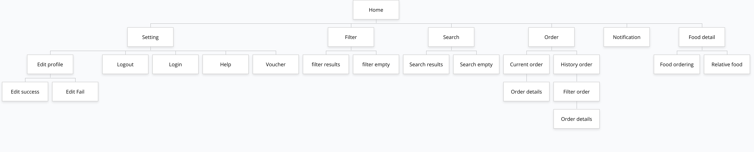
Sitemap
Client

Slide 12
Demo

Slide 13
